Slide 1
WebQuiz Prototype
Work in progress…
Green arrows indicate where you should click to continue with the prototype. If there are more than one arrows then you can click either.

Slide 2
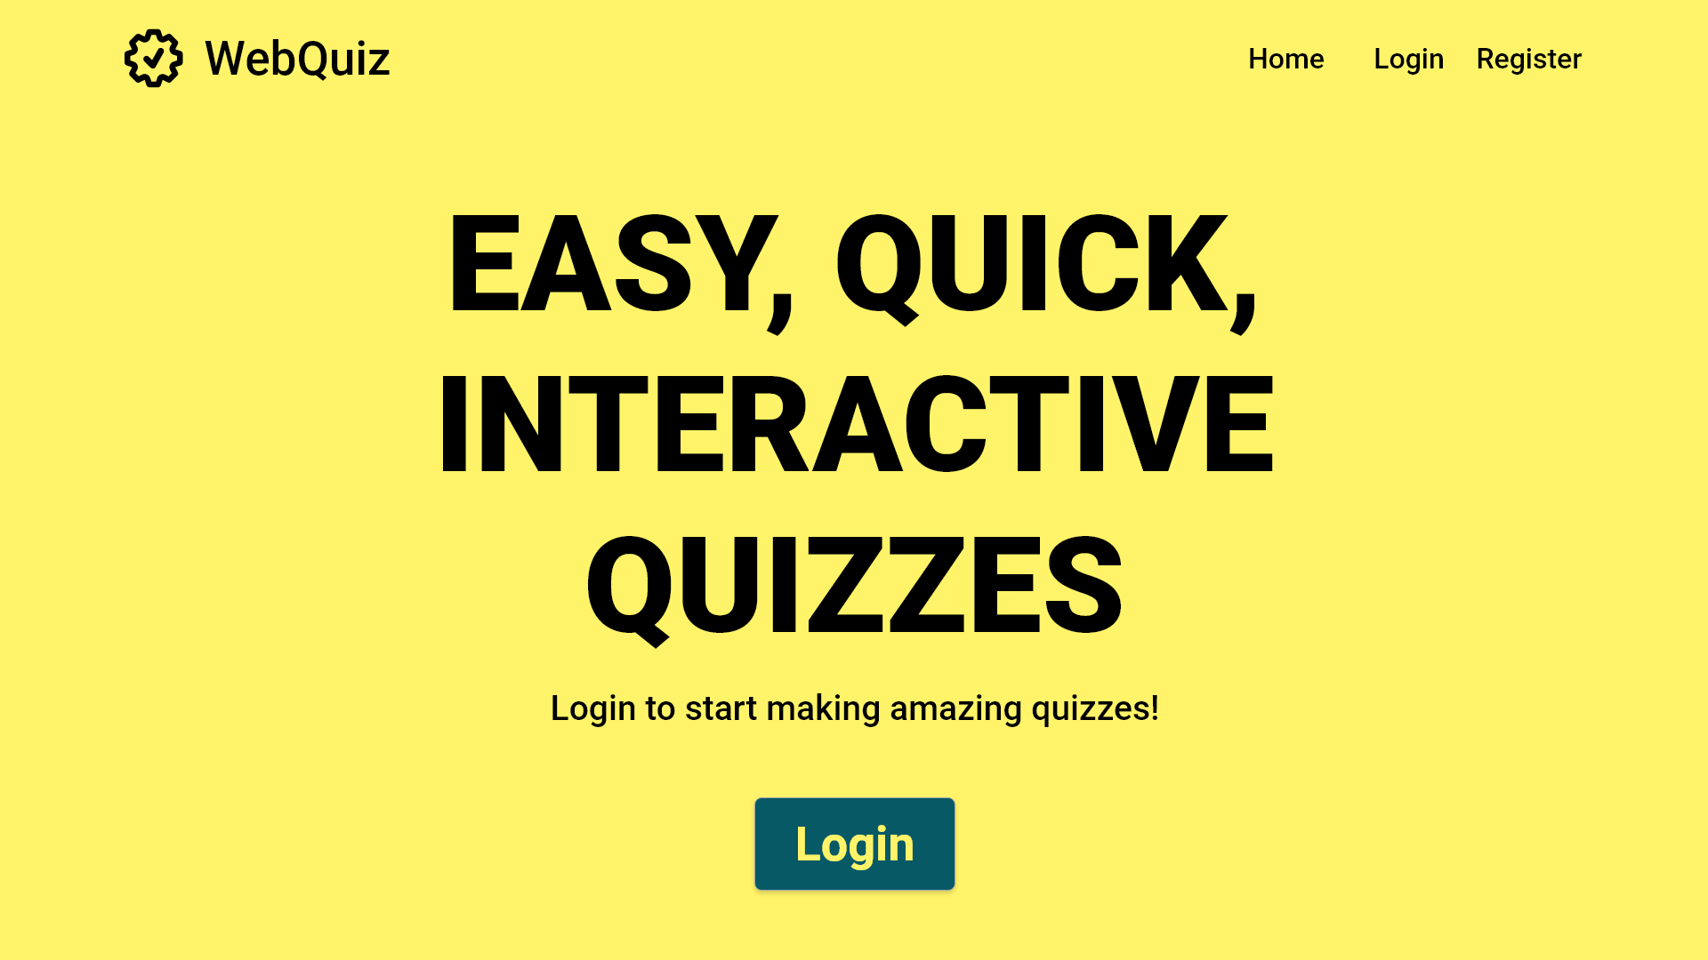

Slide 3
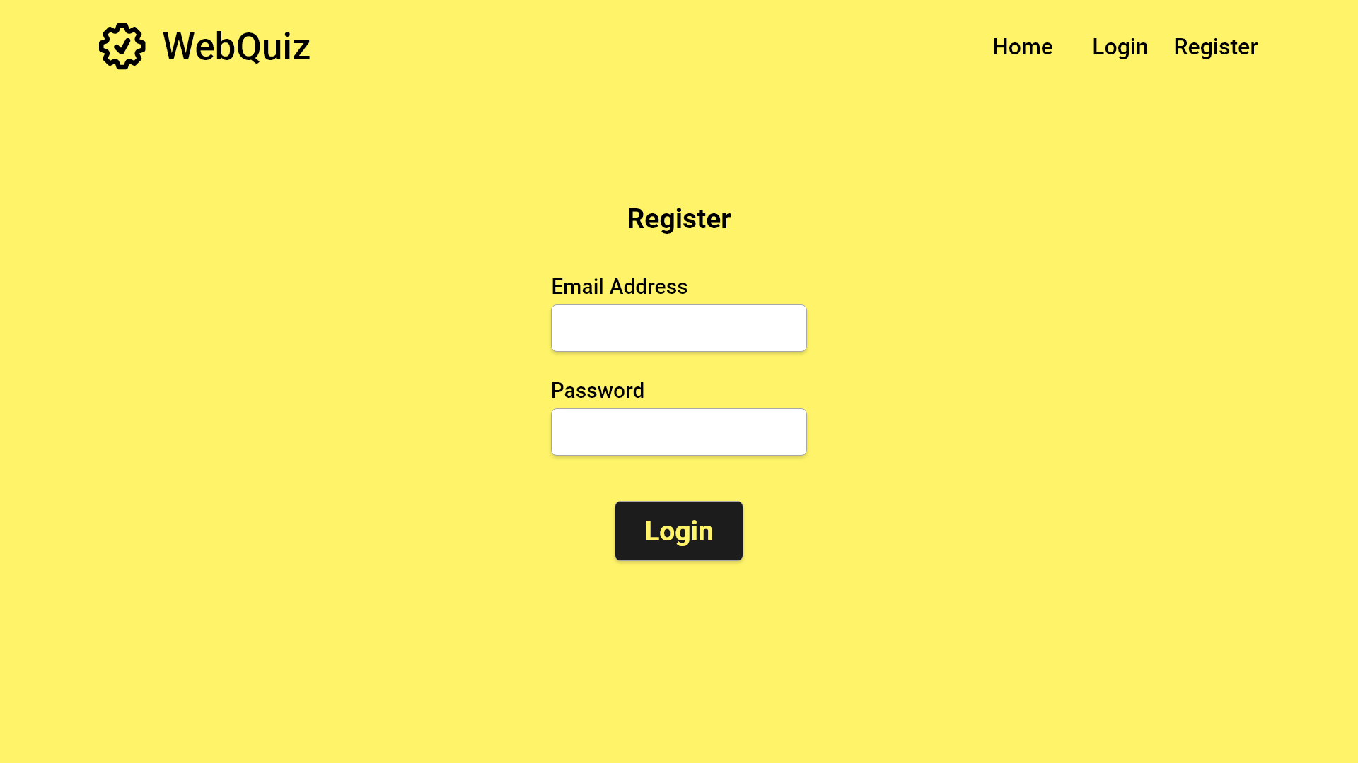

Slide 4
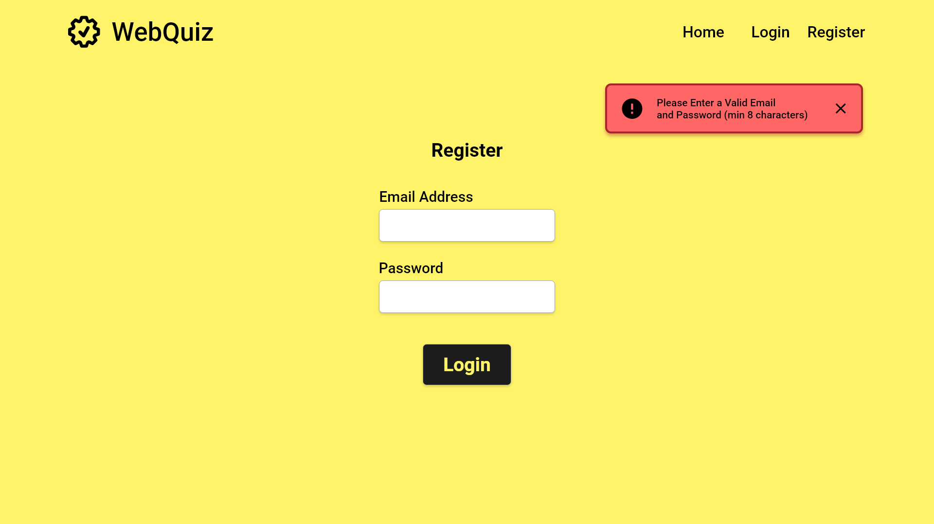

Slide 5
xyz@aber.ac.uk
***********

Slide 7
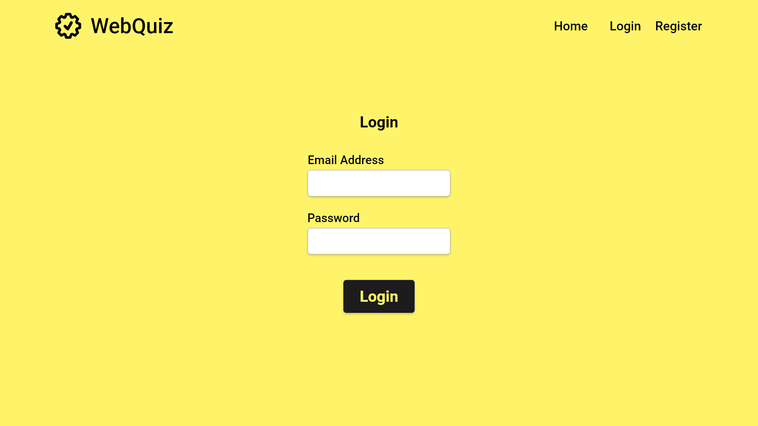

Slide 8
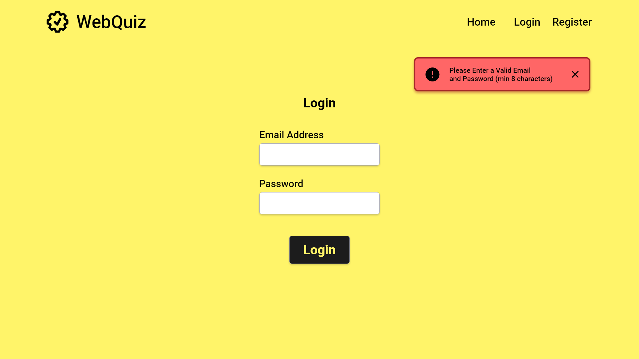
fakeemail@gmail.com
***********

Slide 9
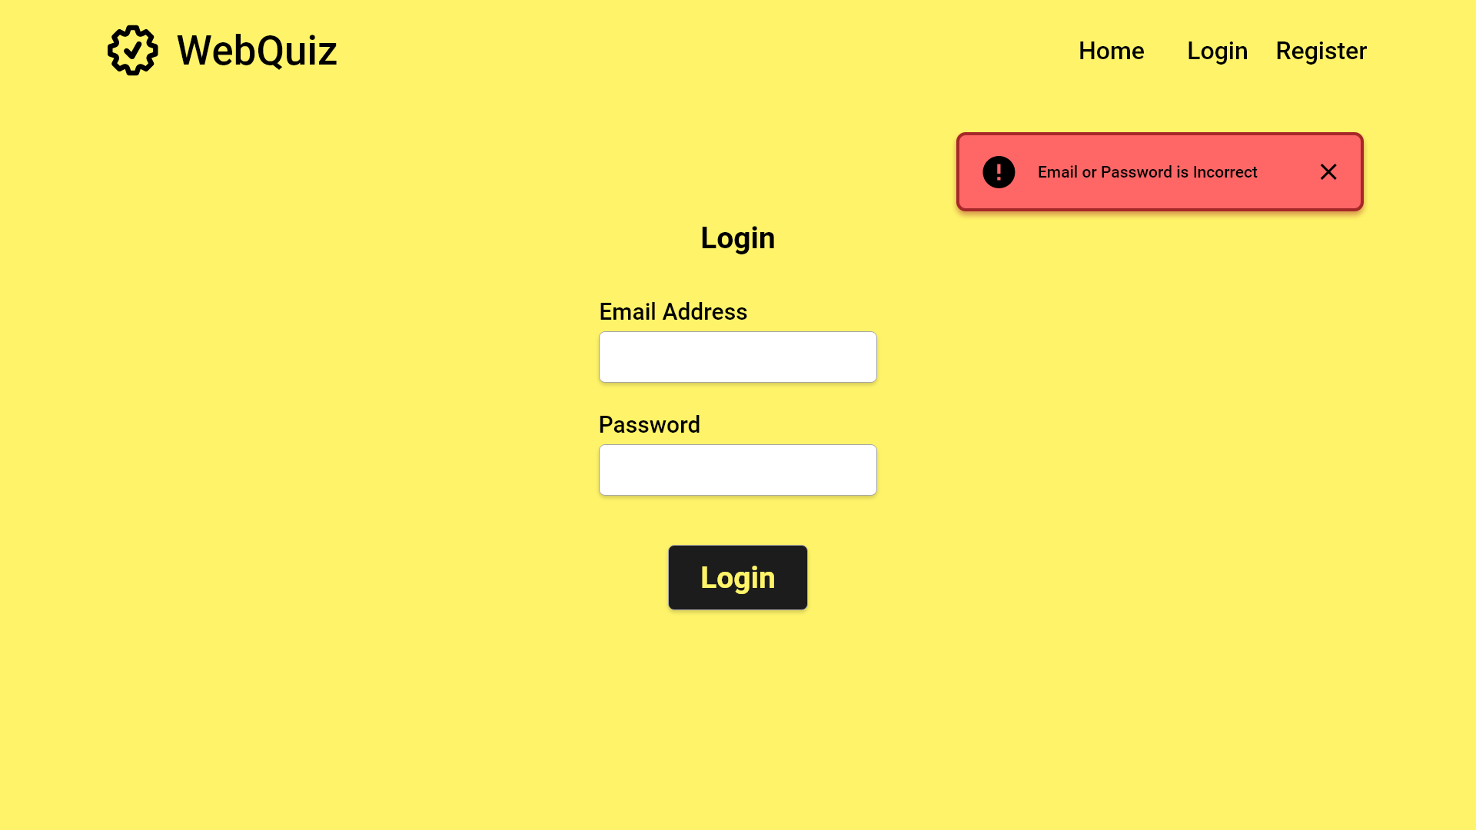

Slide 10
xyz@aber.ac.uk
User fills in both text boxes
***********
Click the button once forms are filled

Slide 11
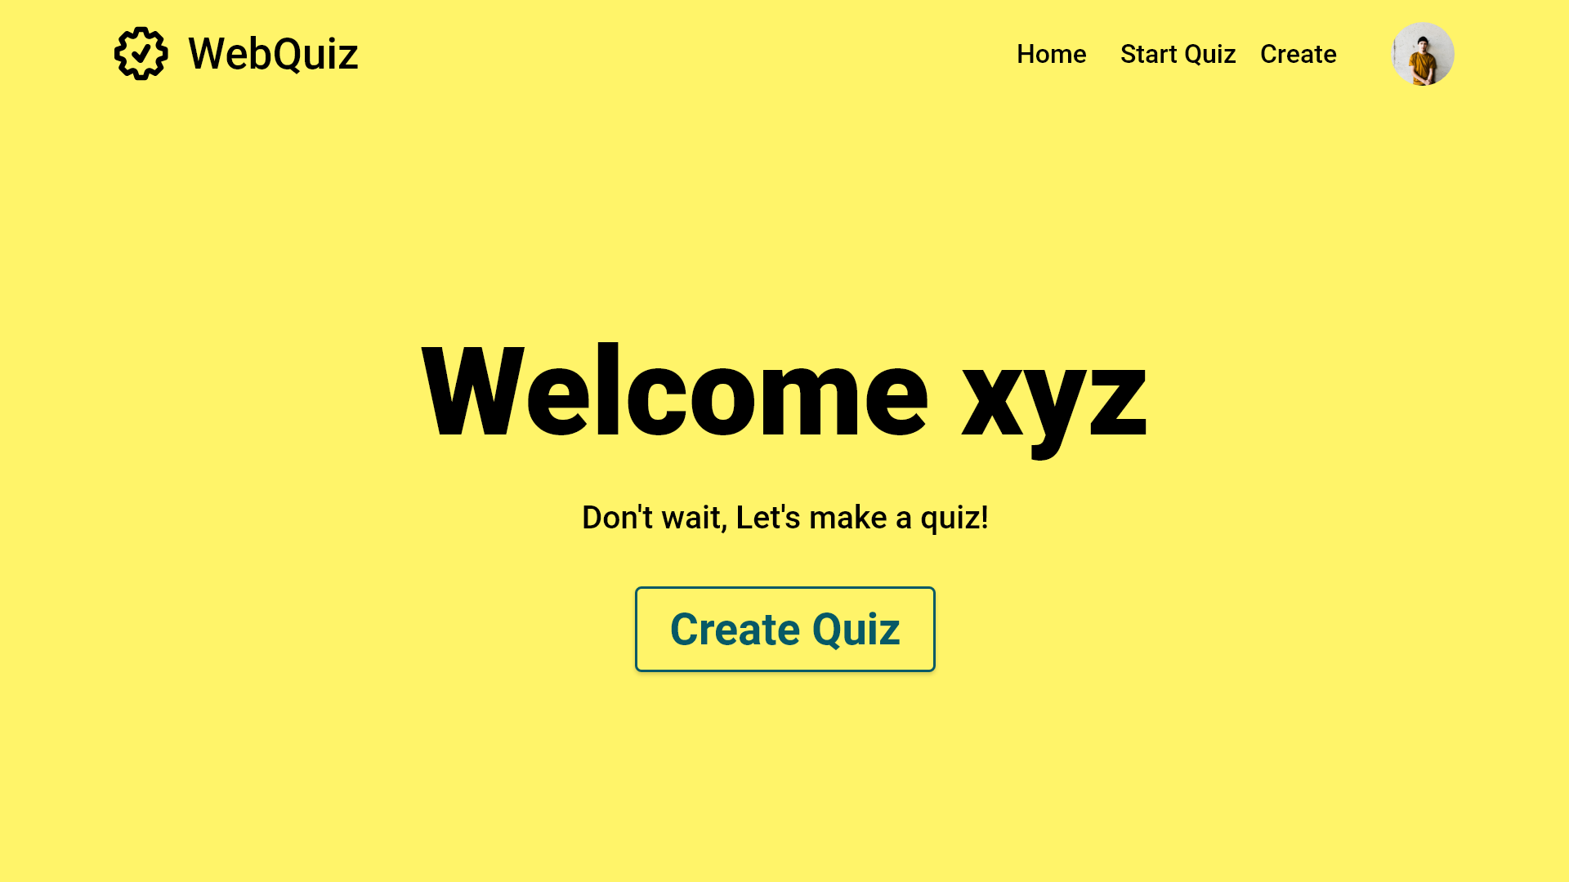
Splash screen containing username. Transitions after a couple of seconds

Slide 12
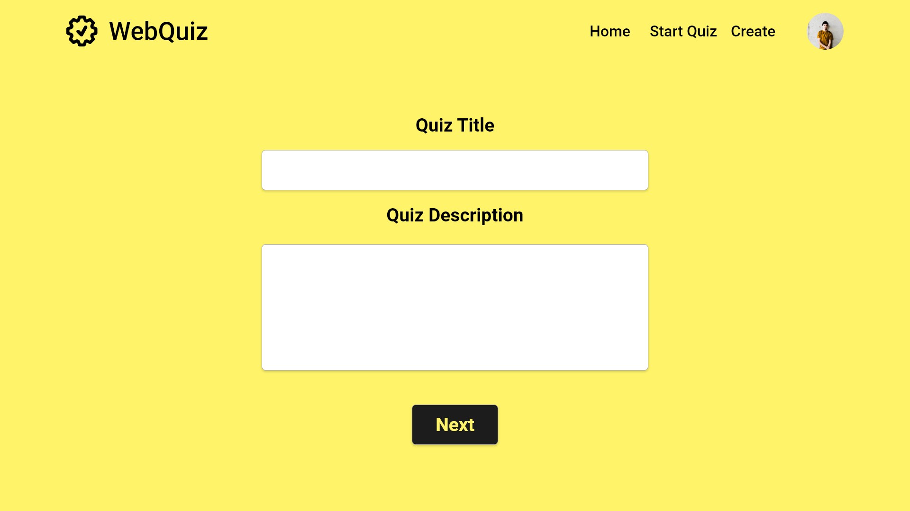

Slide 13
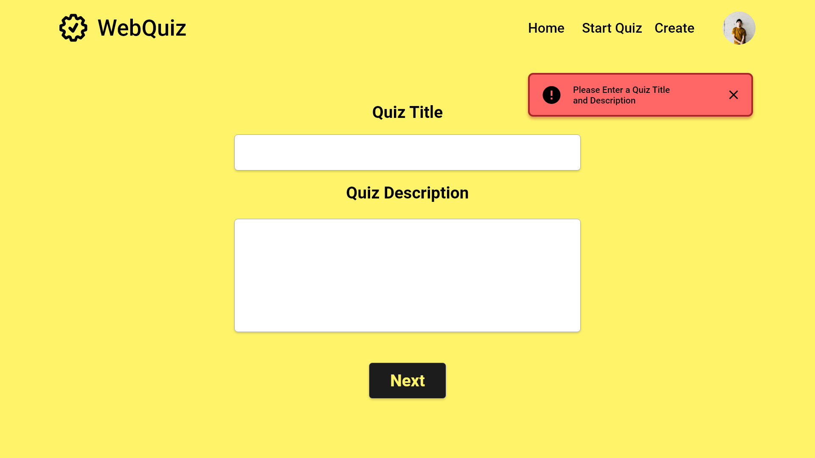

Slide 14
French Language 13
This Quiz utilizes multiple choice and True or False questions.
User enters an introduction for the quiz
Once the textbox is filled the user clicks next to continue

Slide 15
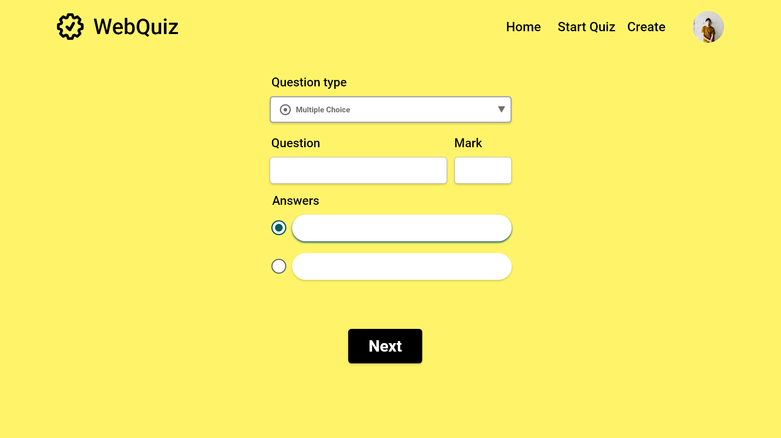

0

Slide 16
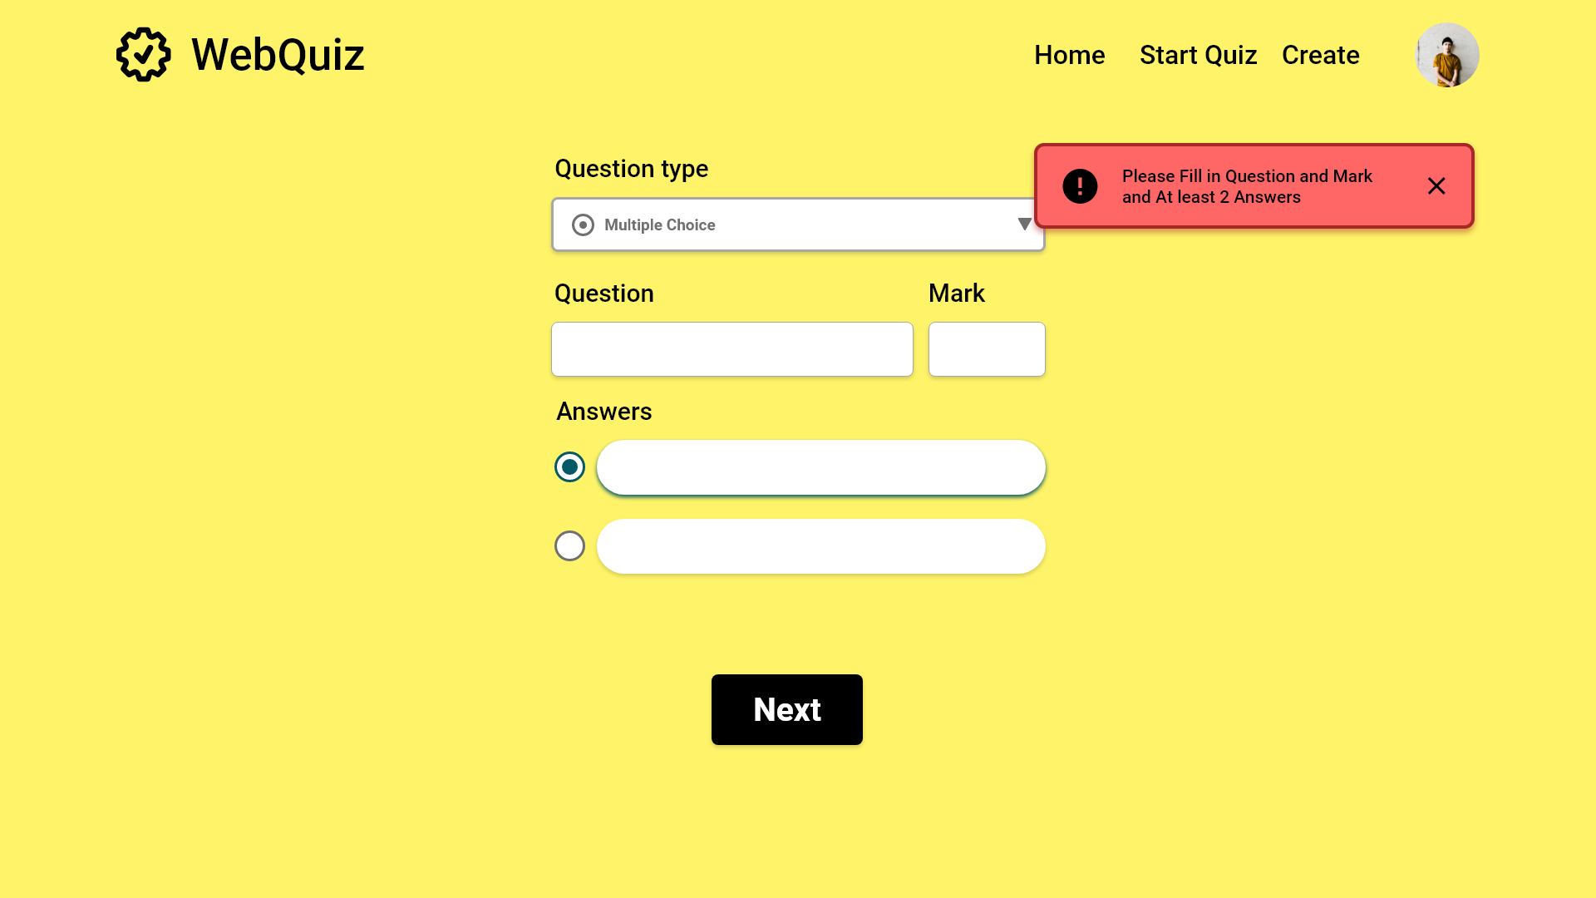
0

Slide 17
User selects a question type from the dropdown menu
What is cat in French?
10
0
Fill in the textboxes and check the correct box
Enter a question in the textbox
Chien

Slide 18
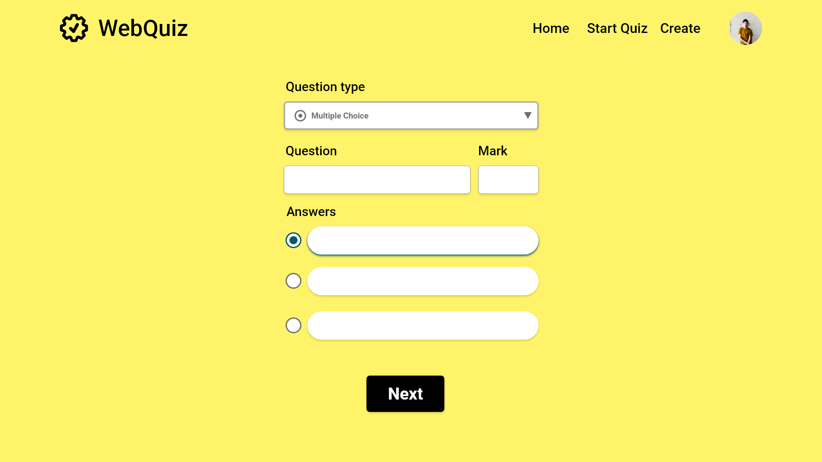
User selects a question type from the dropdown menu
What is cat in French?
10
Fill in the textboxes and check the correct box
Enter a question in the textbox
Chien
Chat

Slide 19
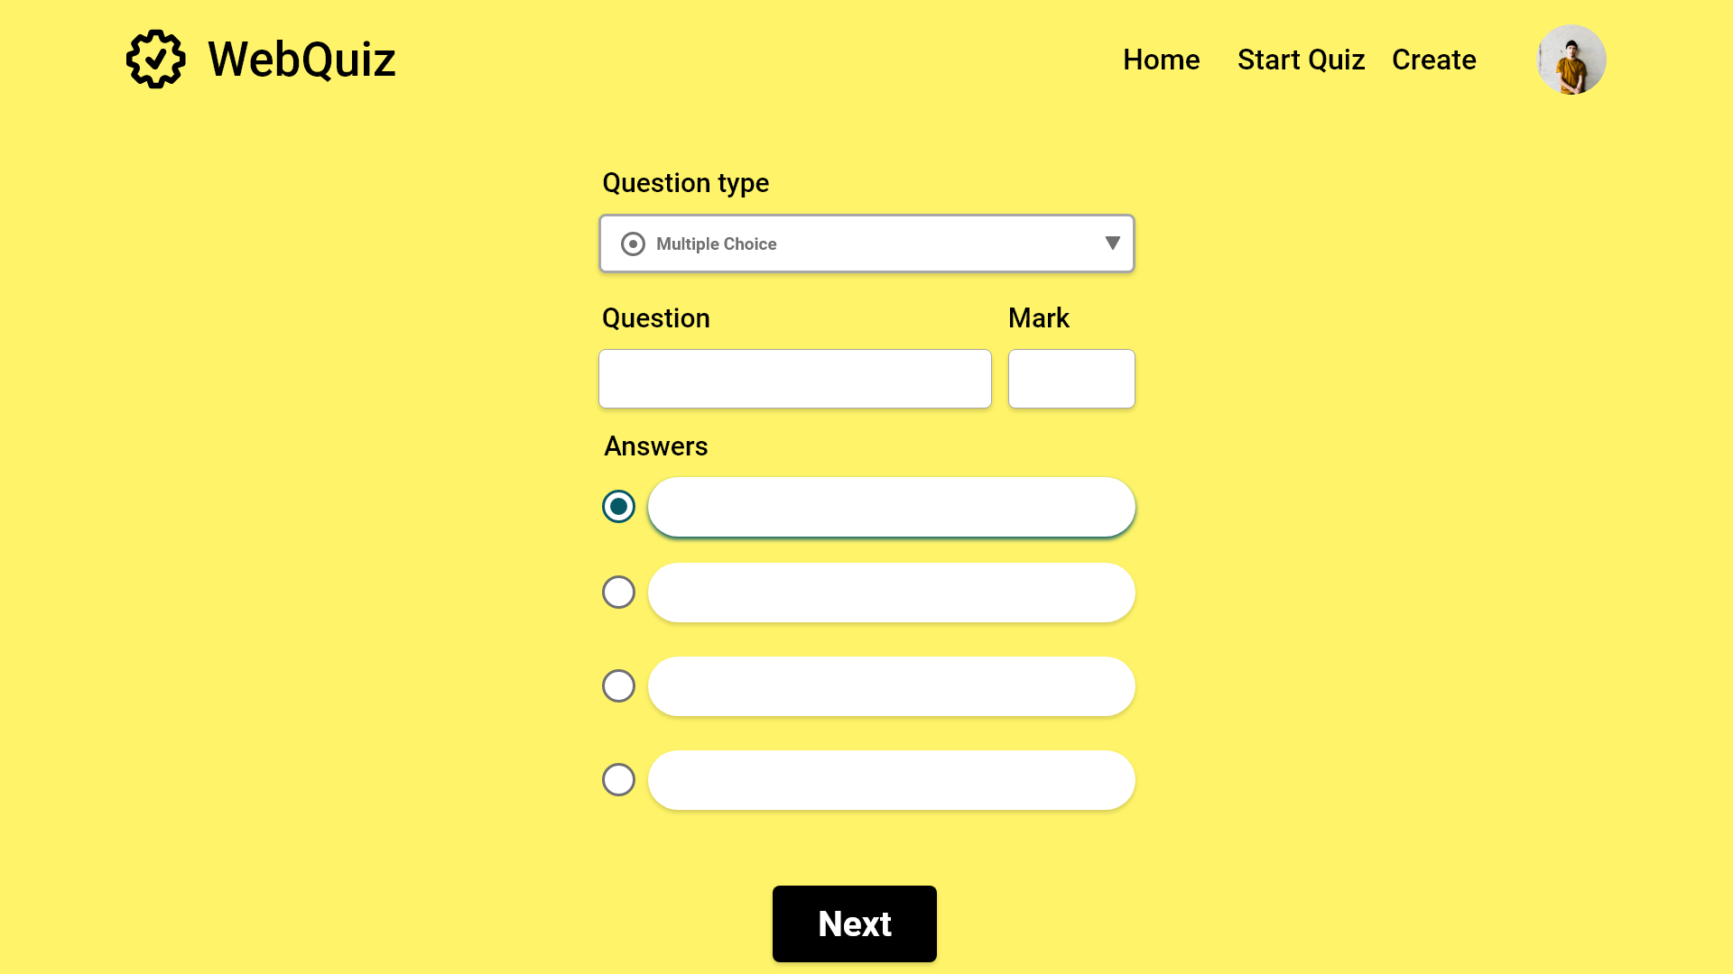
User selects a question type from the dropdown menu
What is cat in French?
10
Fill in the textboxes and check the correct box
Enter a question in the textbox
Chien
Chat
Cheval
Fille

Slide 20
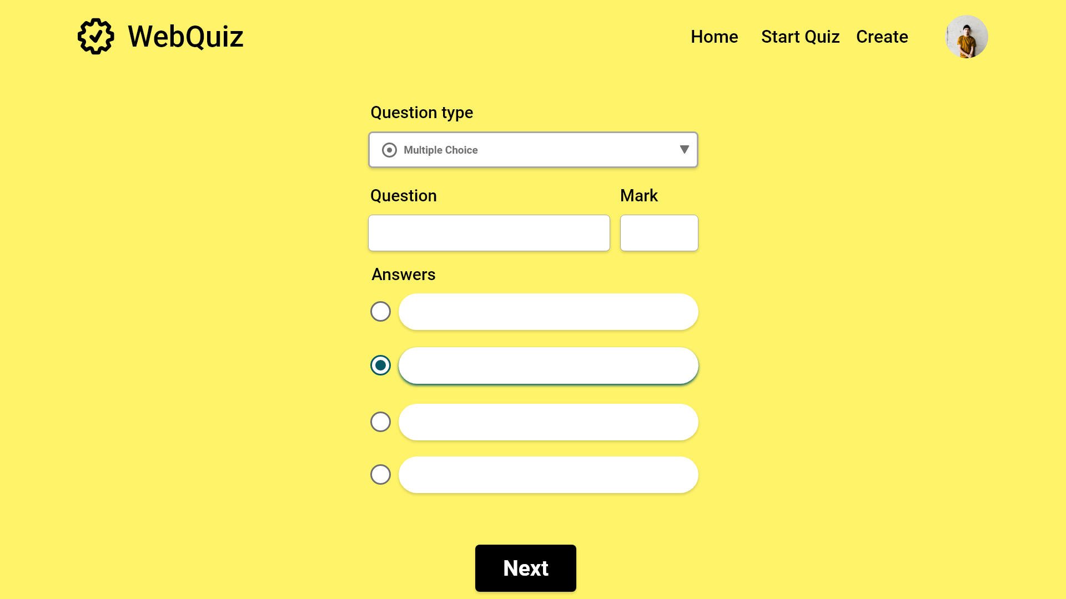
User selects a question type from the dropdown menu
What is cat in French?
10
Fill in the textboxes and check the correct box
Enter a question in the textbox
Chien
Chat
Cheval
Fille

Slide 21
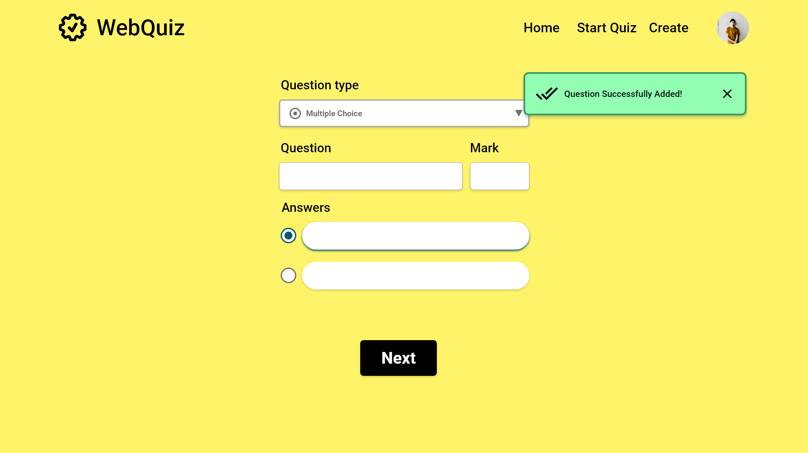

0

Slide 22
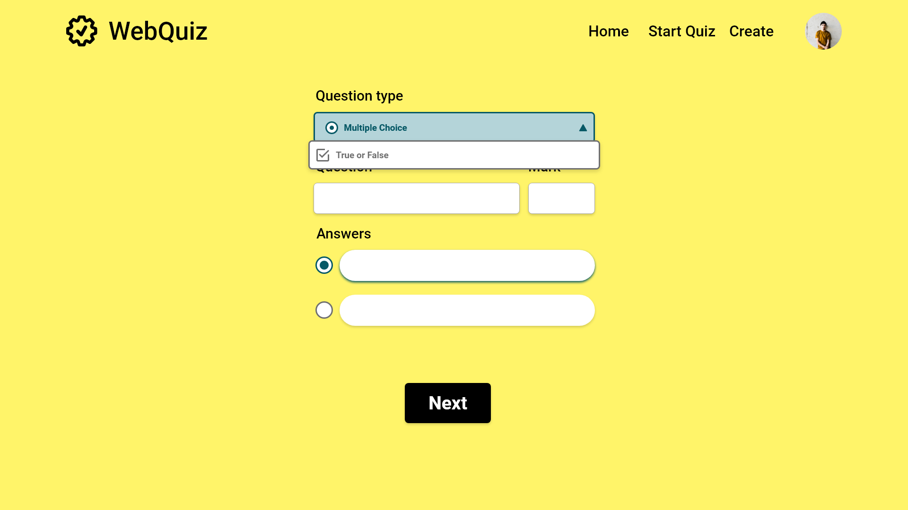
0

Slide 23
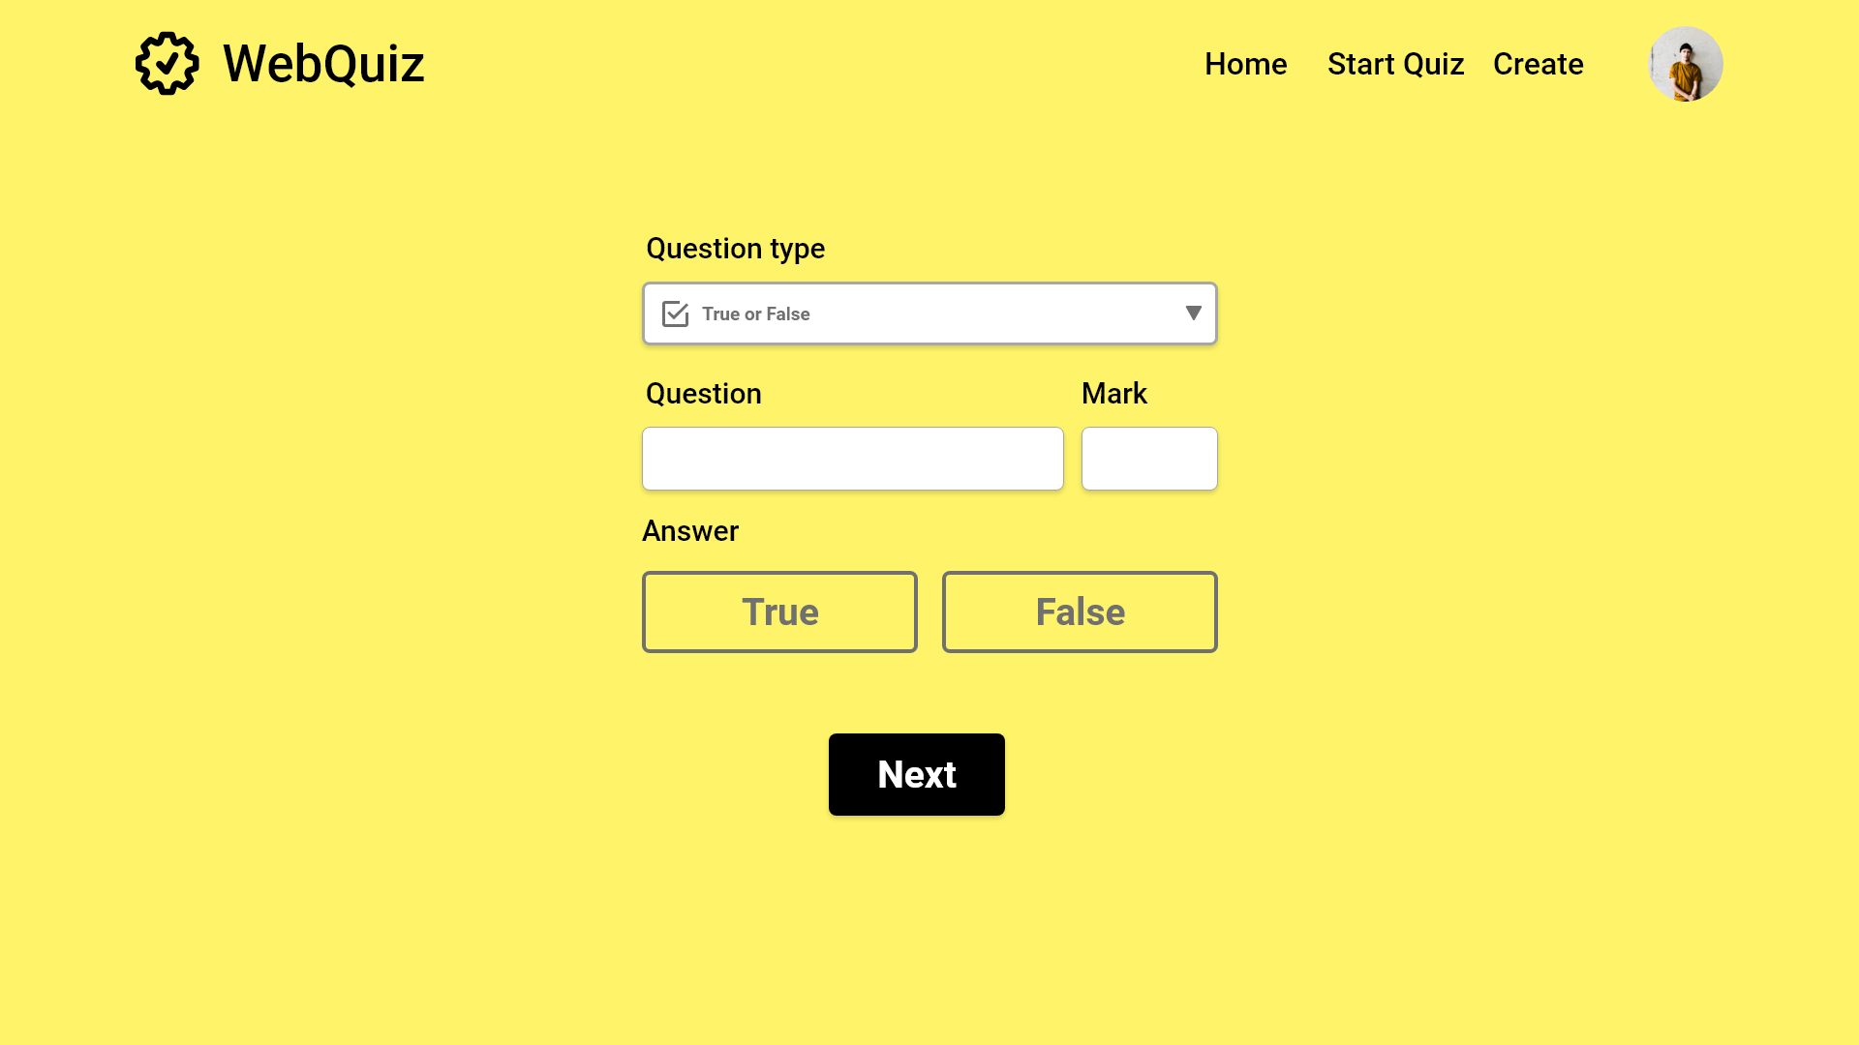
0

Slide 24
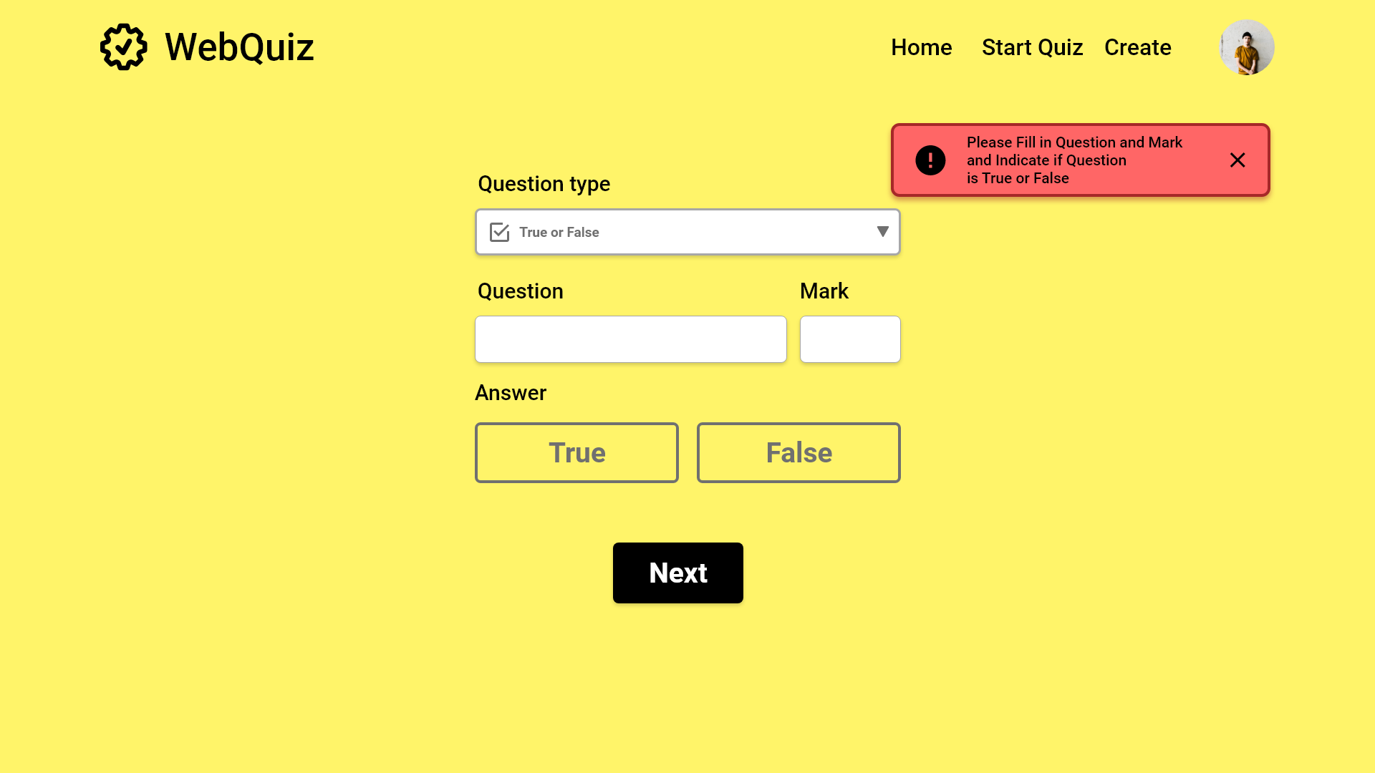
0

Slide 25
Poisson is french for dog
0
10

Slide 26
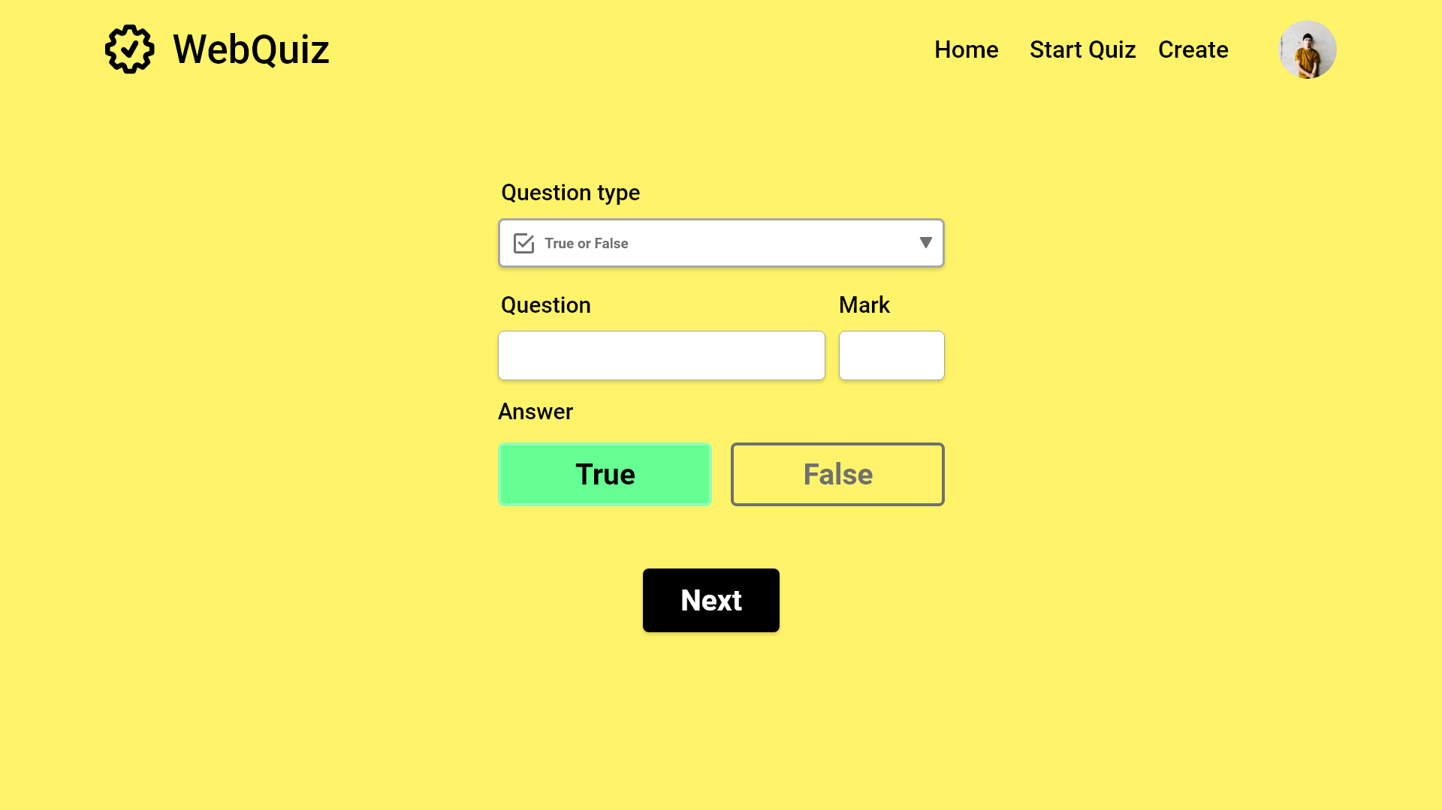
Poisson is french for dog
10

Slide 27
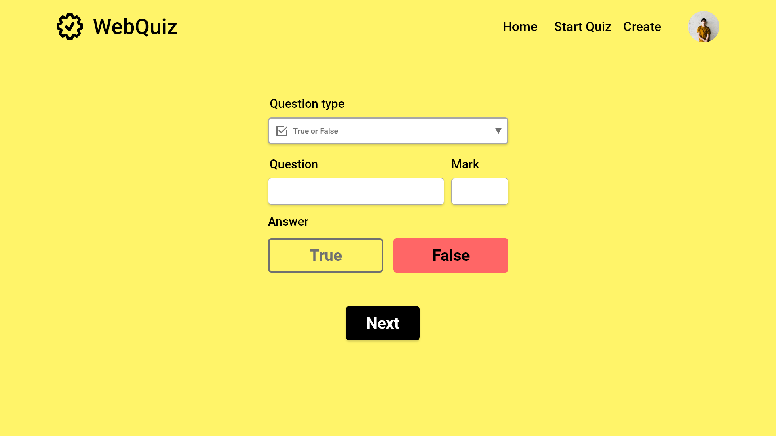
Poisson is french for dog
10

Slide 28
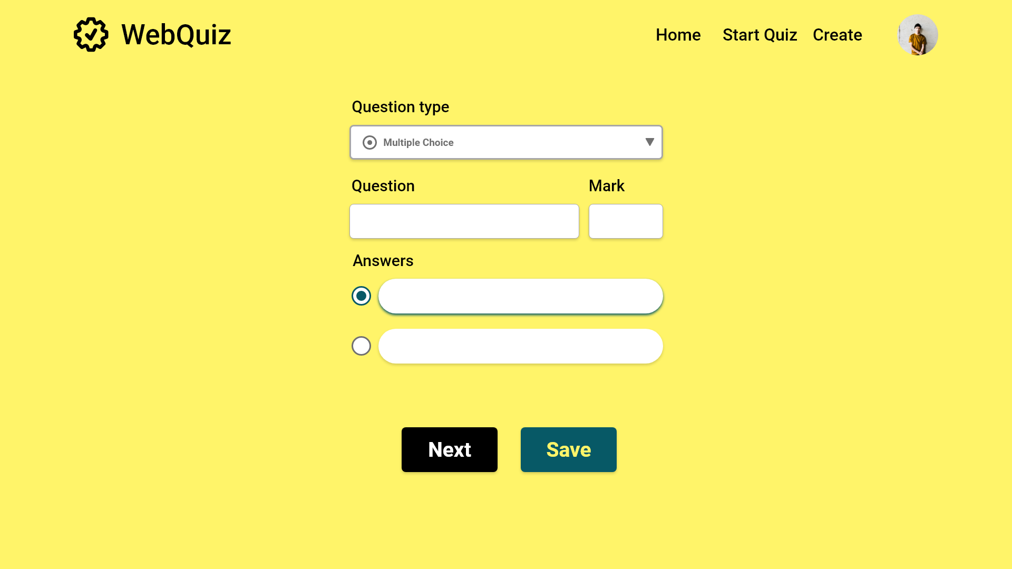


Slide 29
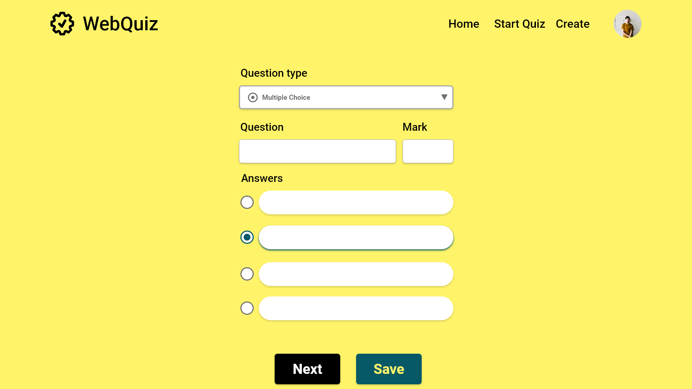
What is cat in French?
10
Chien
Chat
Cheval
Fille

Slide 30

What is cat in French?
10
Chien
Chat
Cheval
Fille

Slide 31
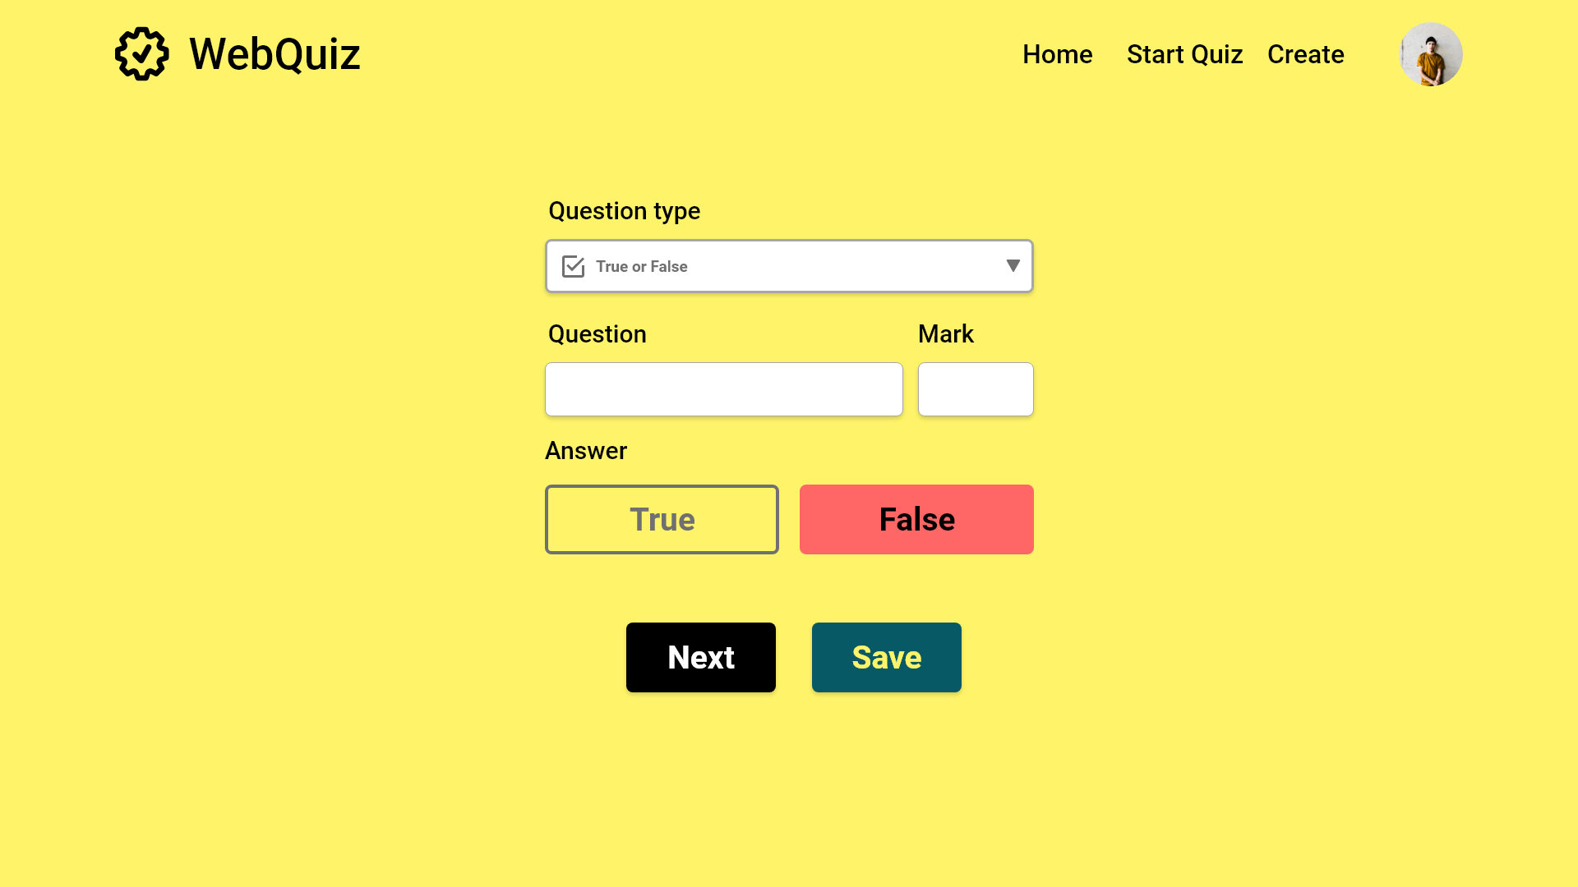

Poisson is french for dog
10

